Slide 1
Capstone Project – The Battle of Neighborhoods
Location analysis for launching new hotel in Bangkok
Kuntida Uampranee

Slide 2

Business Problem
Bangkok is the capital of Thailand. Before the pandemic began, Bangkok was one of the world’s top tourist destination cities. Each year approximately 22.7 million international visitors arrive in Bangkok. Also, MasterCard ranked Bangkok as the top destination for global travelers. Till now, there are millions of people have been vaccinated around the world. The travelling will return soon. To serve the travelers around the world are looking forward to visiting Bangkok, the lodging is dedicated to perfecting the travel experience. Therefore, if we can help decision making on finding the potential location to construct new hotel. It can reduce the risk of investors.
This project tries to understand the preferences of each district by leveraging venue data from Foursquare’s “Places API” and “K-means clustering” machine learning algorithm.

Slide 3


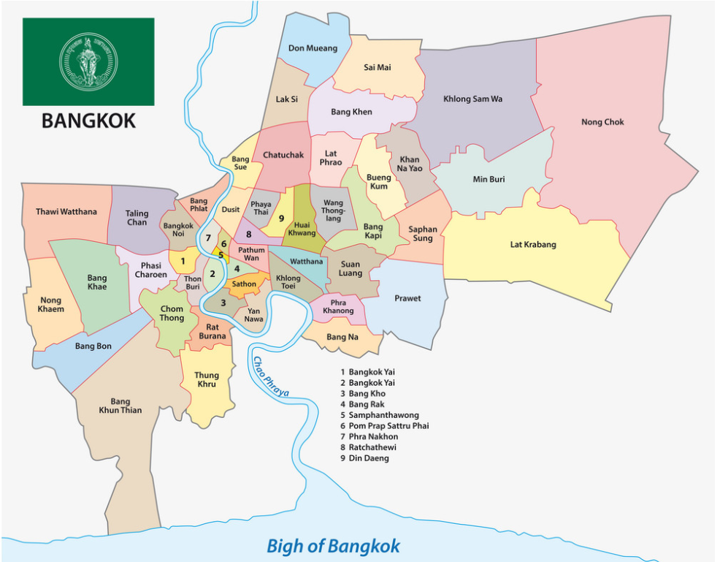
Data Acquisition
The list of districts get from this https://en.wikipedia.org/wiki/List_of_districts_of_Bangkok link
Venue data from Foursquare API, to perform clustering on the districts

